Slide 1
EduCON Education & Conversation Tool
ALES – udruga Alumni Europskih studija
Association of Alumni of European Studies
Social Innovation Competition
Croatia 2016

Slide 2
Why? Building Social Capital
It is not enough to fight.
It is the spirit which we take to the battle
that decides the issue.
It is morale that wins the victory.
George C. Marshall

Slide 3
Citizens and government Conflict/Collaboration = Participation
Social networks – Facebook, Twitter, fora (forum.hr science fora, etc.)
FULL deliberation
REAL TIME decision making

Slide 4
Windmills of change
Competitive advantage of nations
Case of Netherlands
Electric cars in Croatia
Scarcity or abundance?
Energy should be used productively

Slide 5
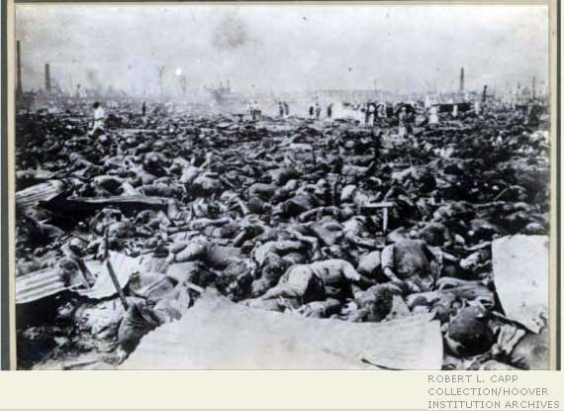
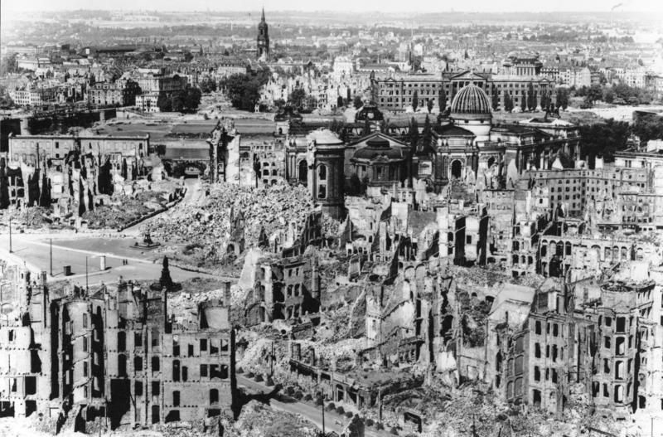
Disruptive innovation??

Slide 6
Project leader, partners and their roles
Business = Book block (NGO of firms) – promotion of materials, marketing, etc.
Academia = Croatian Institute for Public Administration (scientific institute registered as an NGO) – evaluation and support
Civil Society = IDEMO - NGO (think tank) – implementation and development
Civil society and academia = ALES - project leader; development of the idea; project management and implementation

Slide 7
Other prospective partners
University of Zagreb
University of Split – CEDI Robert Schuman
University of Rijeka
City of Rijeka
City of Zagreb
City of Split
Ministry of Science, Education and Sport

Slide 8
Public activity, reading, involvement and failing book market in Croatia
27% of students do not read at all (source: OECD)
57% reads if they must
80% does not have reading as a favorite hobby
40% citizens reads at least 1 book per month (e.g. Germans – 73%, Italians – 71% etc.) – source: GfK
Ideally 4 million books should be sold in Croatian market, in 2004 and 2005 it was 11 million, but in 2009 it was 2,5 million in bookstores and 1 million in shopping malls; in 2010 and 2011 sales fell by 30-40%.
There is no market for e-books and it should have ate least 4000 e-books published in Croatian language

Slide 9
Activities of the Book Block
Connecting with other stakeholders
Continuous monitoring&needs assessment
Round tables
Discussions and presentations
Promotions
Other events that can promote book sales or specific topics

Slide 10
Activities of iDEMO
Assisting with architecture of the app
Testing on users
Launching the pilot campaign
Assisting in dissemination of results in the publich
Continuous monitoring&needs assessment
Round tables
Discussions and presentations

Slide 11
Triple helix – Quadruple helix
Government
Citizens
Business
Discussion
Deliberation
Information
Consultation
Participation

Slide 12
Reaction to an urgent problem Curricular reform; education reform
Large number of potential users
Users from academia and other walks of life
Common goals and interests
Lack of political activism
High usage of smartphones
SOLUTION:
MOBILE APPLICATION

Slide 13
Kingdon – policy streams
Problems
Solutions
Political will

Slide 14
Our solution European mobile & web based forum
Weighted multicriteria voting on answers
Rating participants; ability to reply in real time
Real time - fast and efficient
Mobile application easy to use
Ability to get feedback and info
Proposed expert literature, links
Advice on how to argue better
“modern crossover between
Facebook, vBulletin, Linkedin...”

Slide 15
Where it might be useful
It is difficult to connect employers and academia in order to determine specific skills that employees should possess in order to get employed
Potential employees (e.g. students) are not used to non-linear thinking, in order to be employable
Although there already exist employment portals, such as posao.hr or moj-posao.net, they are static, and it is known that employers nowadays like to check Facebook accounts of potential employees in order to assess them, as well as linkedin and other profiles they find useful; therefore, it is an opportunity for potential employees to present their skills

Slide 16
Prospective customers
 | General population (e.g. students) | Academia Specialists Educators Small business | Public Administration
CORPORATE BUSINESS | B2C Marketing research, etc. | B2B Employee and partner selection | B2G Education reform
GOVERNMENT | G2C Policy making | G2B External consultant pool | G2G Civil servant evaluation
NGOs CITIZENS | C2C Awareness campains | C2B Social responsibility and advocacy | C2G Fundraising Advocacy

Slide 17
NGOs
Advocacy
Employment
Market development
Policy making – Education reform
BUSINESS MODEL
CREATING A NEW TYPE OF
SOCIAL DYNAMICS
“ALTERNATING” INSTEAD OF “TOP-DOWN” OR UNIDIRECTIONAL POLICY MAKING IN “BIPOLAR” SOCIETY
Academia
CHANGE
Citizens
Business
Government
DEMAND:
QUALITY OF LIFE
DEMAND: JOBS
DEMAND SKILLS

Slide 18
Progressive development - matching
G2C
Policy making
Curricular reform
B2G
Education reform
Demand for employee skills
C2B/G
Advocacy for civil rights
Socially responsible business

Slide 19
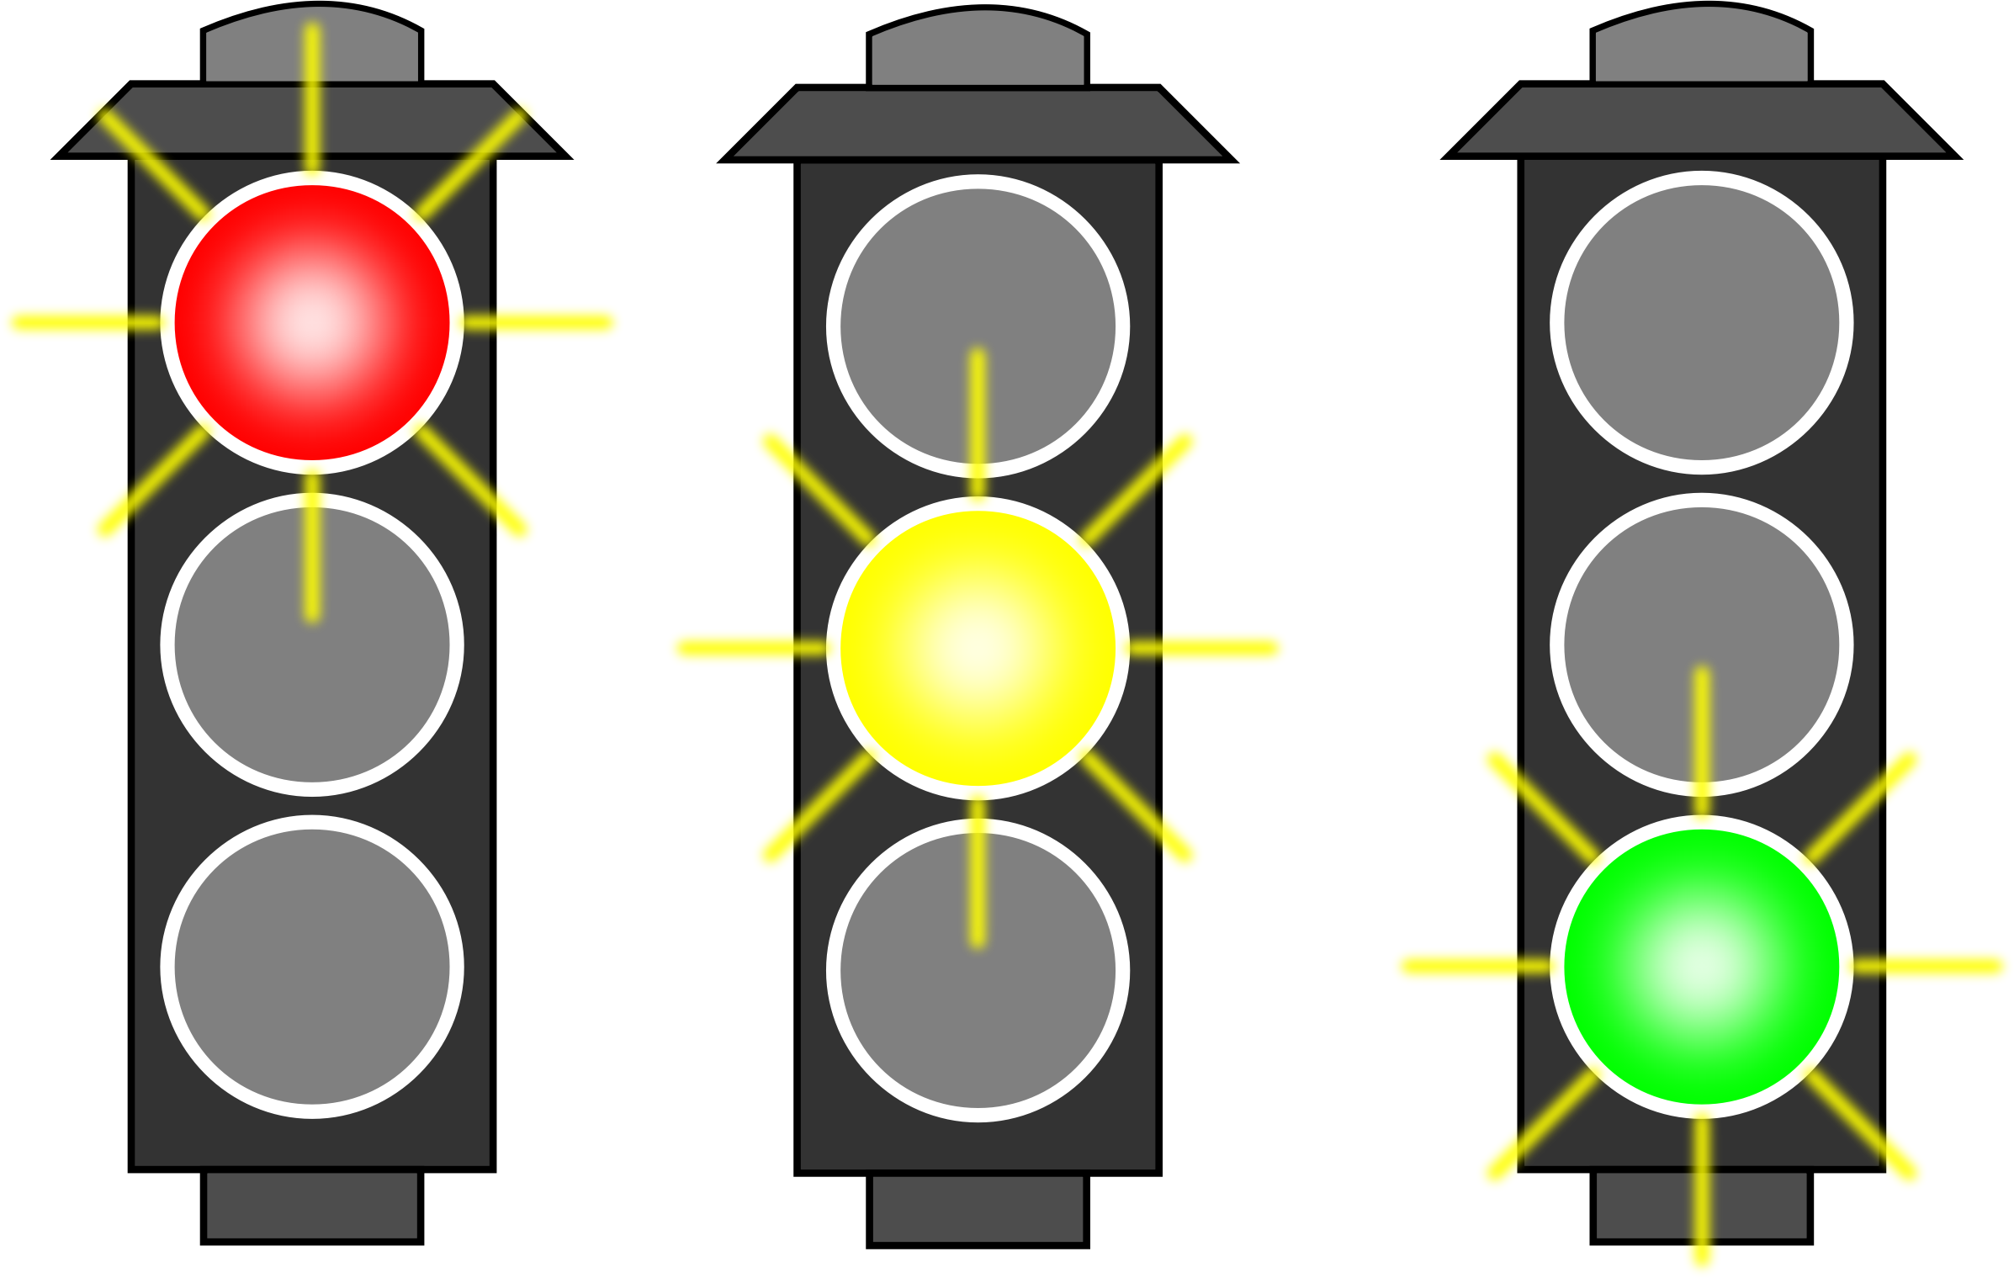
Financial sustainability
Would people pay?
Free application; charge for advertising (professional and business users) and premium users (able to put topics on agenda)
BASIC USER
BUSINESS USER
PREMIUM USER

Slide 20
Market segmentation

Slide 21
SWOT analysis
WEAKNESS (OF VIRTUALLY ALL NEW NETWORKS AND DISCUSSION FORA): IMPORTANT THING TO REMEMBER IS THAT THE VALUE OF A NETWORK GROWS WITH THE NUMBER OF USERS, WHICH EXPLAINS THE RESILIENCE AND SUSTAINABILITY OF FACEBOOK AND OTHER LARGE NETWORKS: IT IS THE LARGE NUMBER OF USERS AND NOT NECESSARILY THE QUALITY OF THE SERVICE. THEREFORE, THE IMMEDIATE GOAL IS TO ACQUIRE A SUFFICIENT NUMBER OF USERS, AND THAT IS DIFFICULT TO ACHIEVE
OPPORTUNITY: ONGOING CURRICULAR REFORM AND POLITICAL WILL THAT MAY ALLOW OUR PROJECT TO GAIN INITIAL USERS
THREAT: POSSIBLE LOSS OF POLITICAL WILL OF THE GOVERNMENT TO CONDUCTED THE REFORM, LACK OF INTEREST
STRENGTH: OUR NETWORK HAS THE EXPERIENCE OF PREVIOUS MODELS, WHOSE WEAKNESSES HAVE BECOME APPARENT OVER THE YEARS, AND CAN USE NEW, MOBILE TECHNOLOGIES TO ATTRACT USERS AND REACH THEM, DUE TO UBIQUITY OF SMARTPHONES IN CROATIA.

Slide 22
Need for funding
Budget
Idea development
10000-50000 euros
Possible funding: H2020 programme
Pilot project
500000 euros
Possible fundng: H2020 programme
Rolling out
1-2 million eur
Possible funding: ISA²
Europe for Citizens
CONNECTING EUROPE FACILITY (CEF)
Link up with the existing Futurium project – ISA²
DIGITAL SINGLE MARKET
FP8. EU funds

Slide 23
Outcomes and outputs
Better cooperation of academia, business, government and citizens on Educ. & Tranining
Constructive and efficient dialogue online
Opening Croatia to cooperation on EU level
A new, European user centered and dialogue based social network

Slide 24
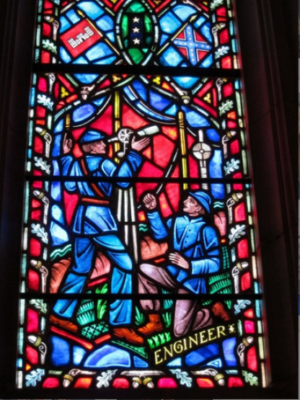
The only meaning of my work lies in the effort to assure a real, humane, just and free community – for everyone and everywhere; a community that not only tolerates diversity, but also cheerfully welcomes it, just as the builders of Chartres cathedral felt cheerful when they constructed their rosettes from multicolored pieces of glass.
Vlado Gotovac

Slide 25
Thank you for your attention!
Jan Klasinc
ALES
Trg maršala Tita 14, Zagreb
Office: Zvonimirova 48, Zagreb
ales@ales.hr
ajklasinc@gmail.com

